Slide 1
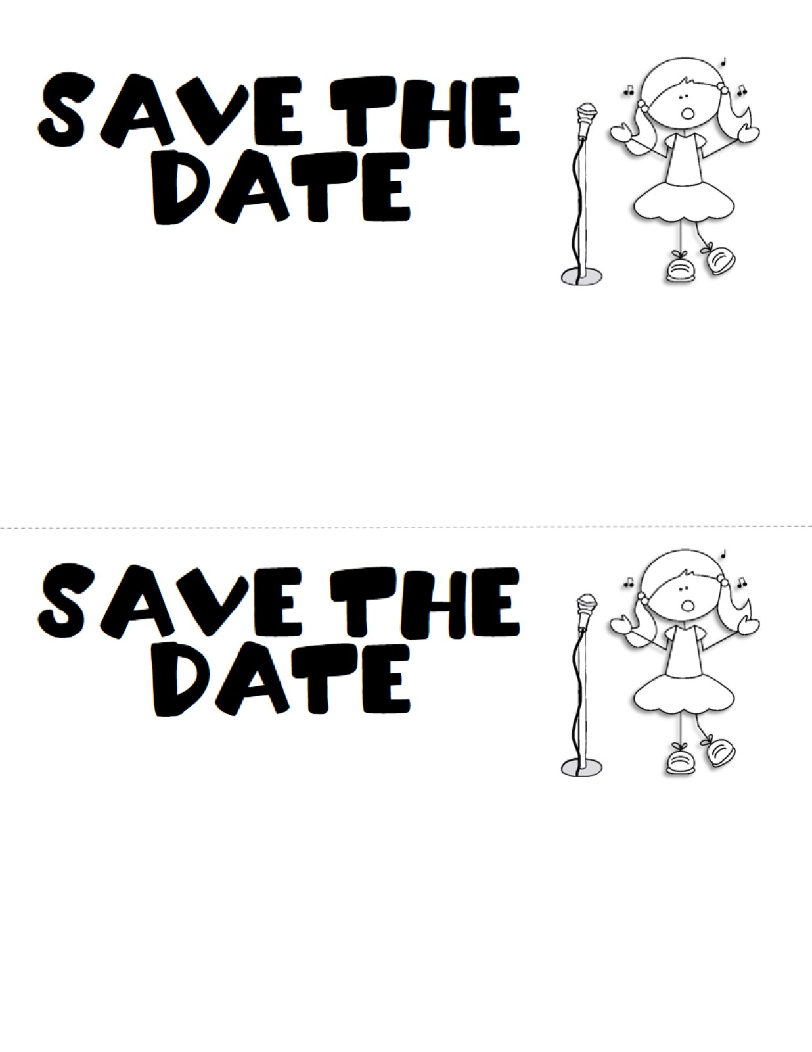
K-1st Grade Spring Concert
The students at James Elementary will be holding a Spring Music Concert on Monday, April 3rd at 6:30PM. The concert will take place at James Elementary School. Detailed Information will be coming soon!
K-1st Grade Spring Concert
The students at James Elementary will be holding a Spring Music Concert on Monday, April 3rd at 6:30PM. The concert will take place at James Elementary School. Detailed Information will be coming soon!

